Slide 1

Progressive Web App
Mostafa Ghadimi
Department of Computer Engineering
Sharif University of Technology
Spring 2019

Slide 2


Special Thanks to:
Amir Hosein Bahrami
Seyed Mehrdad Karrabi

Slide 3
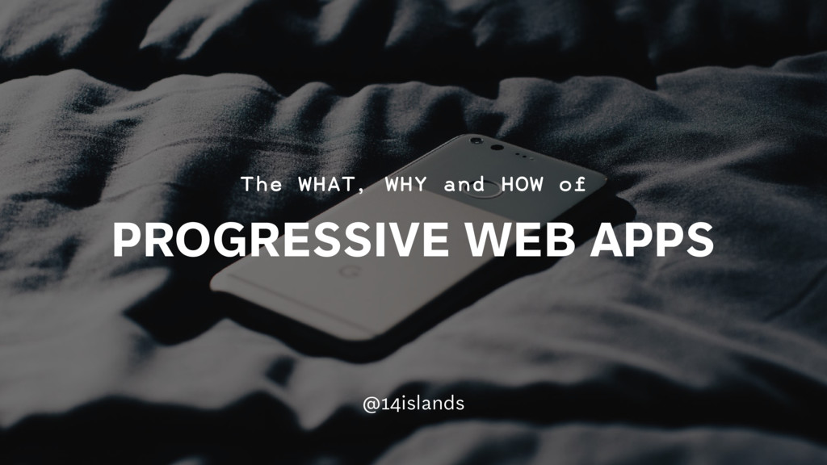

Slide 4


Outline
What is PWA?
Why PWA?
Service Worker
PWA Basics
First Project in PWA
References
PWA (Progressive Web App)

Slide 5
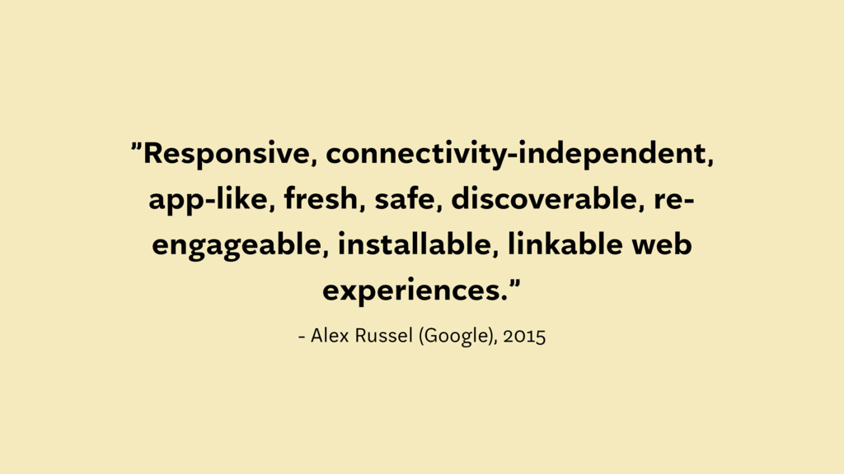

Slide 6


What is PWA?
Installable
Mobile & Desktop
Reliable
Fast
Engaging
Etc.

Slide 7

Installable on Mobile & Desktop
Device Type Independent!
Notes:
When the Progressive Web App criteria are met, Chrome prompts users to add the Progressive Web App to their home screen.

Slide 8
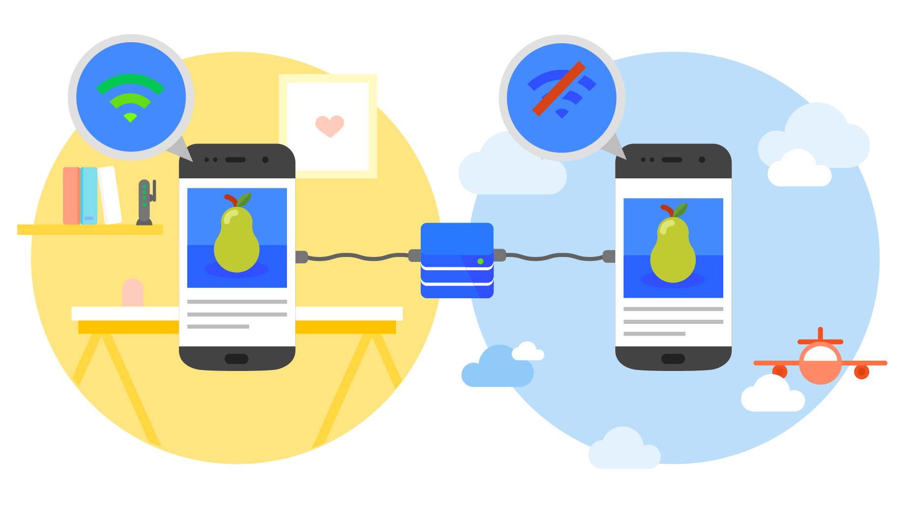
Reliable
Load instantly regardless of network state
Talk about service worker later on.
Notes:
Load instantly and never show the downasaur, even in uncertain network conditions.

Slide 9

Reliable
No T-rex game anymore!

Slide 10

Fast
- 53% abandon a site if it takes longer than 3 seconds to load!
- Once loaded, users expect them to be fast.
Notes:
Respond quickly to user interactions with silky smooth animations and no janky scrolling.
Service workers enabled Konga to send 63% less data for initial page loads, and 84% less data to complete the first transaction!

Slide 11
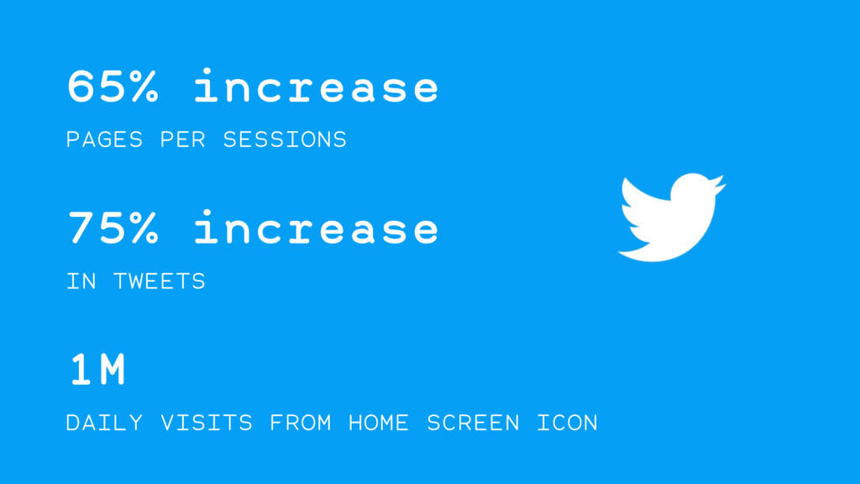

Slide 12
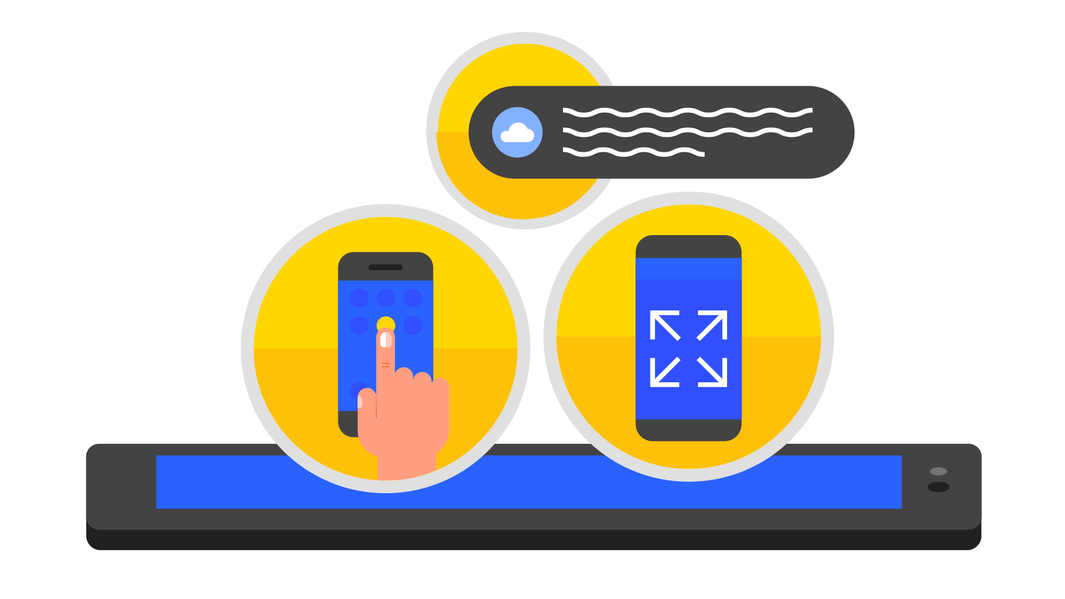
Engaging
- Manifest File
- Push Notification
Notes:
Progressive Web Apps are installable and live on the user's home screen, without the need for an app store. They offer an immersive full screen experience with help from a web app manifest file and can even re-engage users with web push notifications.
The Web App Manifest allows you to control how your app appears and how it's launched. You can specify home screen icons, the page to load when the app is launched, screen orientation, and even whether or not to show the browser chrome.
Web push notifications helped eXtra Electronics increase engagement by 4X. And those users spend twice as much time on the site.

Slide 13

Why PWA?
Faster Development
Easy to Maintain
No need to App store!
Automated Powerful Tools
Debugging in Chrome
Browser Support
Etc.

Slide 14

Faster Development
A native app killer!
Google specific technologies
Notes:
همون‌طور که تو تمرین‌ها دیدیم :)) حتی ساده‌ترین چیزا و نصب اندروید استودیو و اینا خیلی وقت‌گیره!

Slide 15

One Code, All Platforms!

Slide 16




No need to App store
Bypassing Sanctions :))
Notes:
شرکت‌های ایرانی یا هوآوی

Slide 17
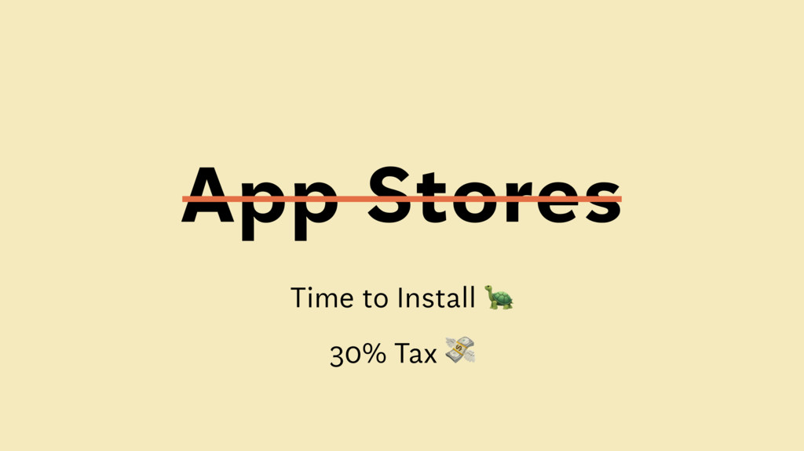

Slide 18


Automated and Powerful Tools
Lighthouse
Workbox
Etc.

Slide 19
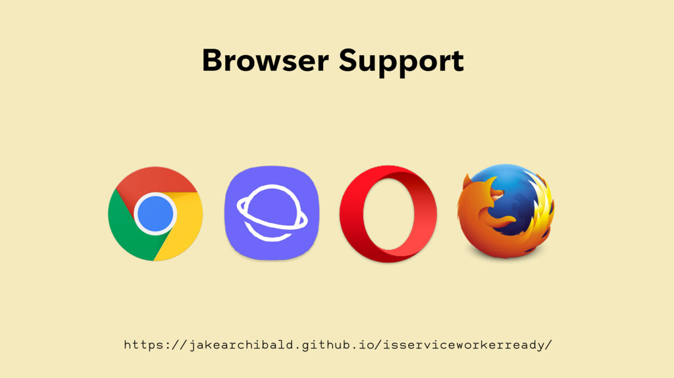

Slide 20
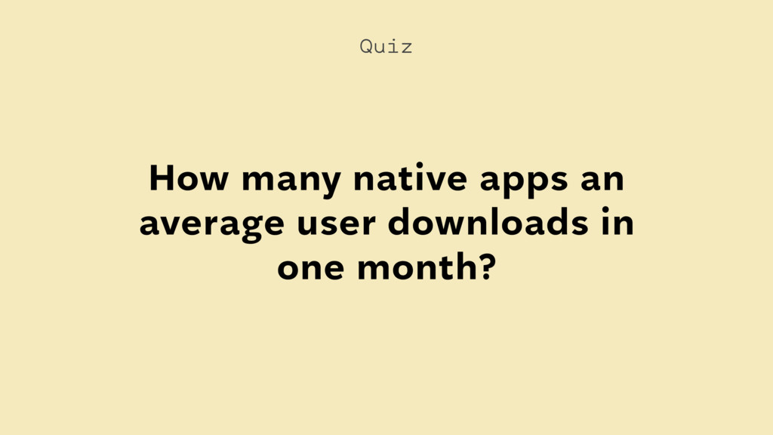

Slide 21
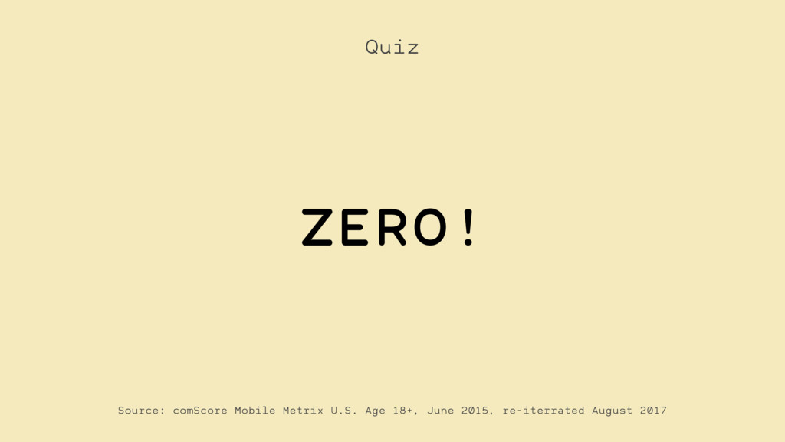

Slide 22
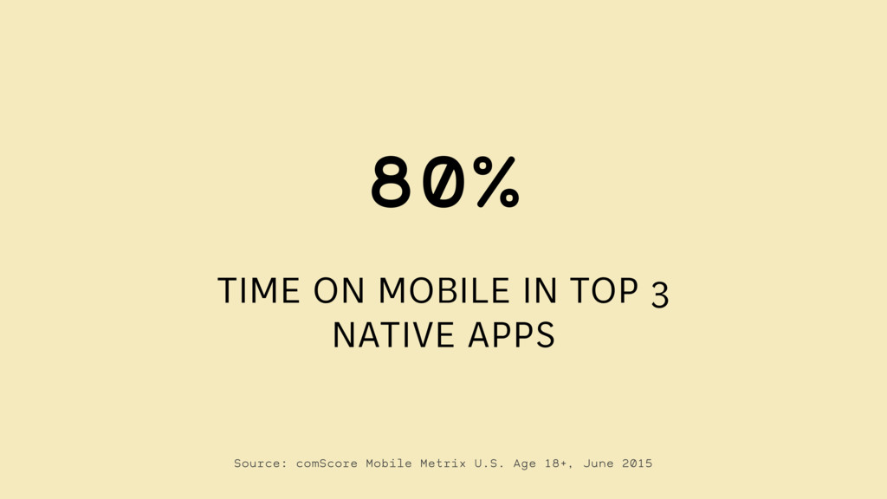

Slide 23
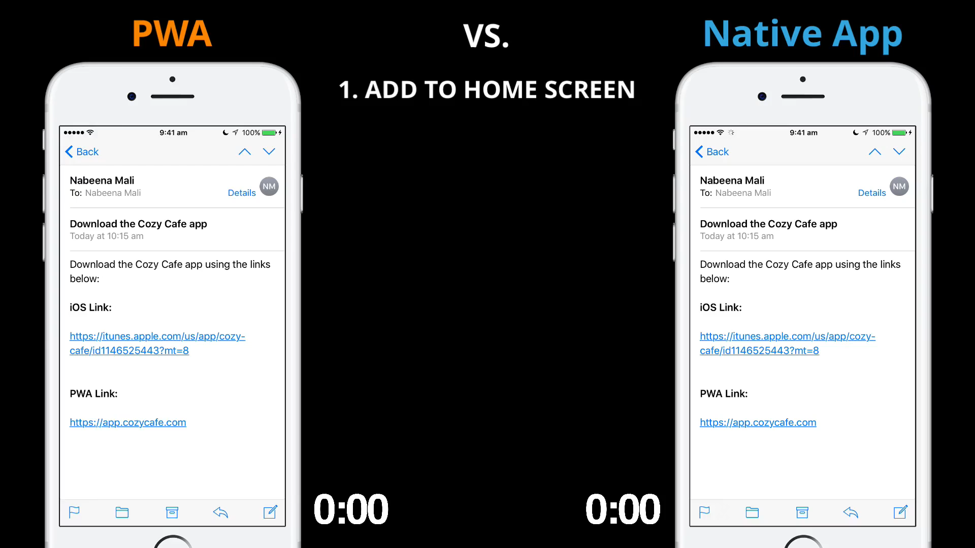
PWA vs Native Apps
Notes:
مقایسه‌ی مالتی ترد بودن یا نبودن و اون شکل nodejs

Slide 24
What is Service Worker?
- A script that your browser runs in the background
- Provides functionality that would normally require a native application, like:
Push Notification
Rich Offline Experience
Periodic Background Sync

Slide 25
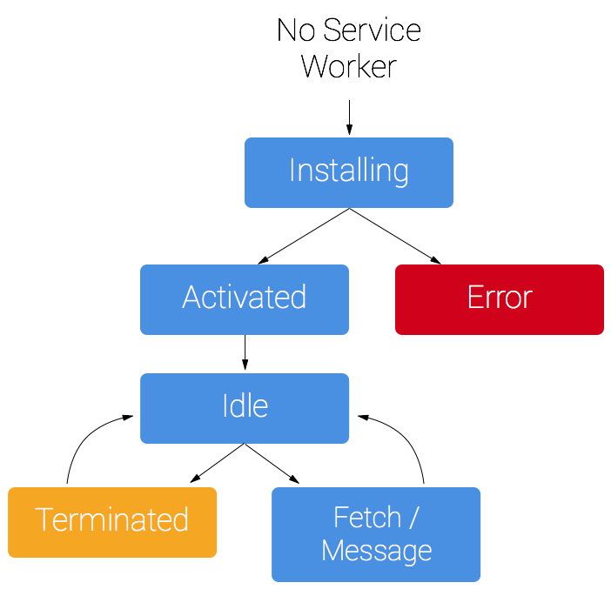
Service Worker Life Cycle
Notes:
Activated: Remove previous cached data from disk

Slide 26
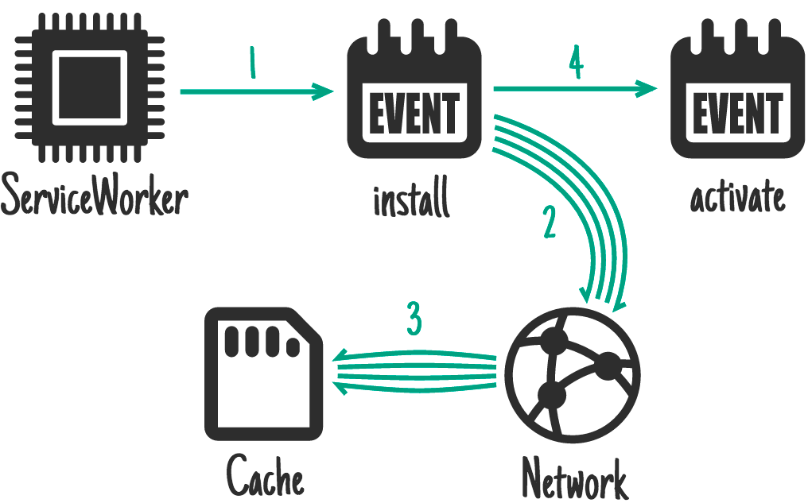
Service Worker Life Cycle
Notes:
Activated: Remove previous cached data from disk

Slide 27
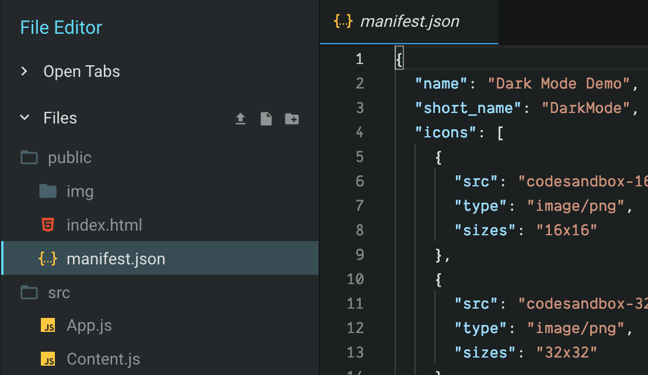
PWA Basics
Manifest.json defines:
Application Name
Theme & Background Color
Display Mode
Orientation
Start URL
Etc.

Slide 28
PWA Basics
Caching:
Register Service Worker
Choose a cache strategy
Caching static resources
Basic Offline Approach
Full Offline Approach (for Static Files)
Caching the App Data

Slide 29
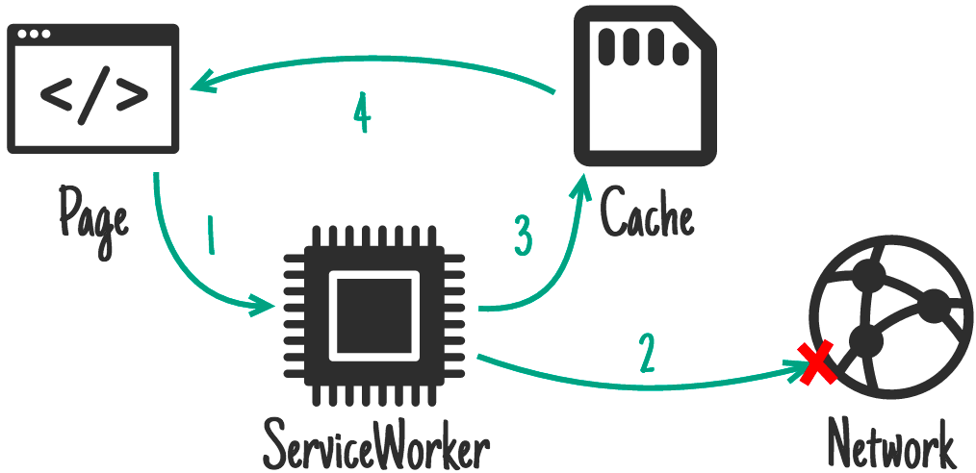
Basic Offline Approach

Slide 30
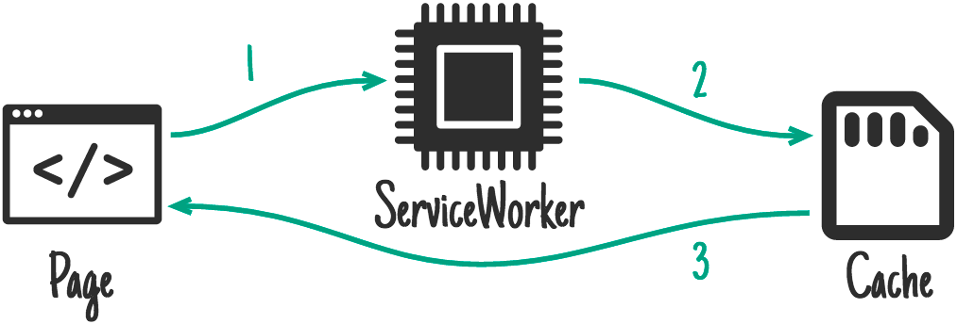
Full Offline Approach

Slide 31
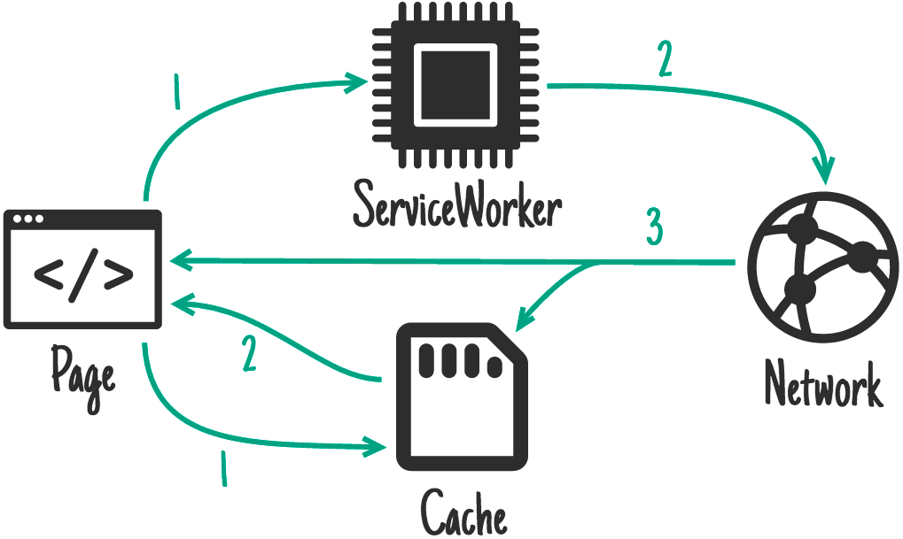
Full Offline Approach

Slide 32




First Project in PWA
Prerequisites:
VS (Visual Studio) Code
Node.JS
Pnpm Package
Create-react-app module
Lighthouse

Slide 33
First Project in PWA
Let’s dive into the first project.
Core Requirements:
HTTPS
App Manifest
Service Workers

Slide 34


Slide 35

Useful Links
Manifest Generator
Favicon Generator
Etc.

Slide 36

PWA Summary
Fast

Slide 37
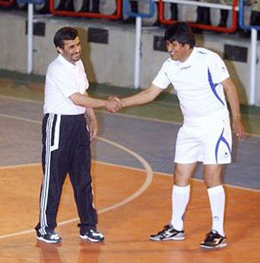
PWA Summary
Engaging

Slide 38

PWA Summary
Reliable

Slide 39


PWA Summary
Cross Platform

Slide 40


